Slide 1

Exploring web apps with Fiddler and Chrome Dev Tools
Cristian Satnic
@csatnic
Avantia, Inc.
Notes:
Invite participants to a discussion – questions, comments (don’t wait until the end)

Slide 2
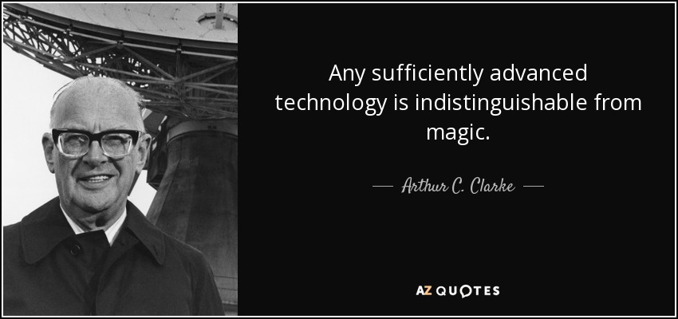
Notes:
Learn how stuff works (especially in technology or with a tool used often)
Don't settle for "it's magic“ even though we probably all did it at some point
It’s just an easy way out – there is ‘no magic’ … it just means that somebody else spent a lot more time thinking about a problem and how to solve it

Slide 3
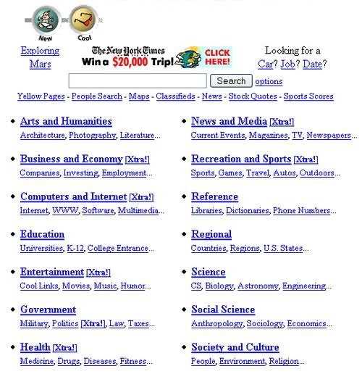
Notes:
Guessing game – what is this?

Slide 4
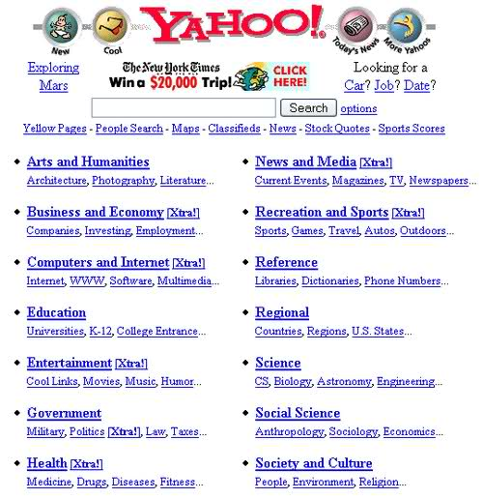
Notes:
Yahoo 1997 – top of the line in web design at that time (Google wasn’t even around)
Good old days when web requests were simple html pages with a few images and other static resources
Now most traffic is probably JavaScript calls, AJAX (or XHR - XMLHttpRequest), JSON, async and so on
Pages with tens/hundreds of external resources and multi-megabyte sizes are not at all uncommon today
Much of the content that's transferred today is ad related

Slide 5
HyperText Transfer Protocol
HTTP/1.1
1997
HTTP/2
2015
Notes:
We added many layers of abstraction, UI frameworks but in the end the HTTP protocol at the basis of the WWW is architecturally still the same as it was 20 or so years ago when the web was born
HTTP/2 - close to 20% of the top 10 million Alexa sites are now using HTTP/2 (most major players do - Google, Facebook, Twitter and so on)
HTTP/2 demo in a later slide

Slide 6
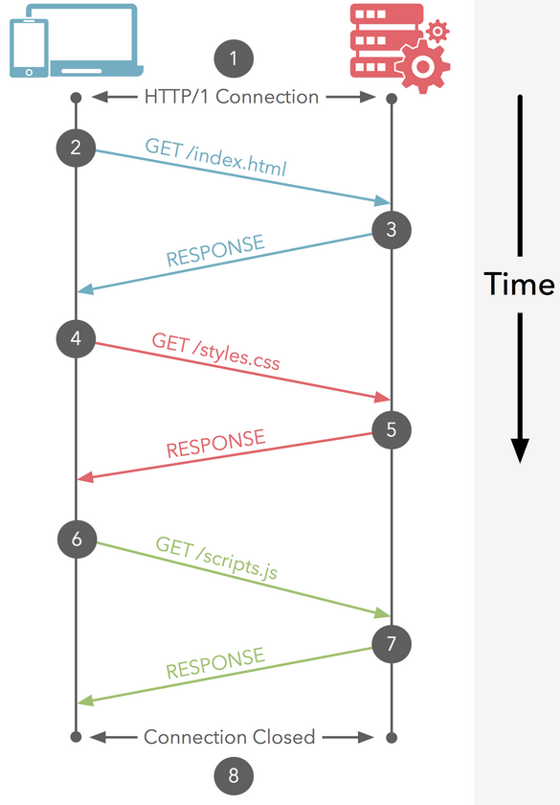
HTTP 1.1 Request / Response
Source: https://cascadingmedia.com/insites/2015/03/http-2.html
Notes:
Understand that typically displaying a 'page' in the browser requires many small & separate requests/responses
Latency and not bandwidth is the problem today (most HTTP traffic is in "short bursts")
Speed of light limitation – how fast can a server respond
Comparison to highway - number of lanes is bandwidth, speed limit is latency ... how to increase the number of cars that go through
Most browsers limit number of parallel connections per domain under http 1.1 (Chrome has a limit of 6)

Slide 7
HTTP Methods
GET
POST
PUT
DELETE
(and others)
Notes:
GET / POST most popular for a long time
The other HTTP methods started gaining traction with the rise of RESTful Web APIs

Slide 8
HTTP Status codes
Successful 2XX
Redirection 3XX
Client Error 4XX
Server Error 5XX
Notes:
Talk about some sample codes
200 – OK
301, 302 for redirect
404 – not found
500 – server error (much pain)

Slide 9
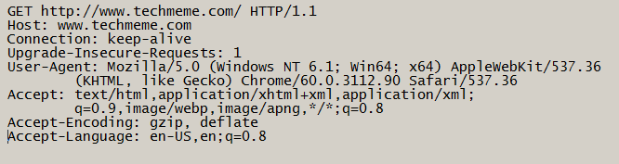
HTTP Request

Slide 10
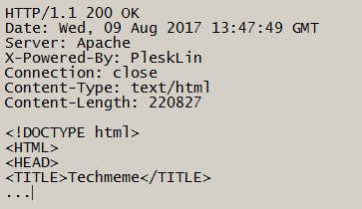
HTTP Response
Notes:
Nice to hackers (we return info we really shouldn’t – Server, X-Powered-By)
Security conscious sites will remove those response headers from their server signatures

Slide 11
Scenarios
UI development
Performance optimization
General troubleshooting
Notes:
UI developer - quickly edit code and see effects real-time
short feedback loop - skip the change & deploy cycle
use Chrome as full IDE
Site performance best practices - make sure those rules are followed
Inspect traffic / calls to make sure the UI layer behaves as expected
Why am I doing this presentation? I'm not a UI person
Trying to get best performance out of backend infrastructure (databases, web servers, network infrastructure)
Needed to understand why the application (UI layer usually) was sending traffic the way it was
Keep browser dev tools or proxy open and monitor web calls made to make sure observed behavior is as expected

Slide 12
Chrome Developer Tools
Notes:
See who’s NOT using Chrome as their main browser
See if everybody is on the same version of Chrome - 60.0.3112.90 as of 8/15/17 (major updates every 6 weeks or so)
All major browsers have similar developer tools - we're focusing on Chrome's version since it's the most popular browser at the moment

Slide 13
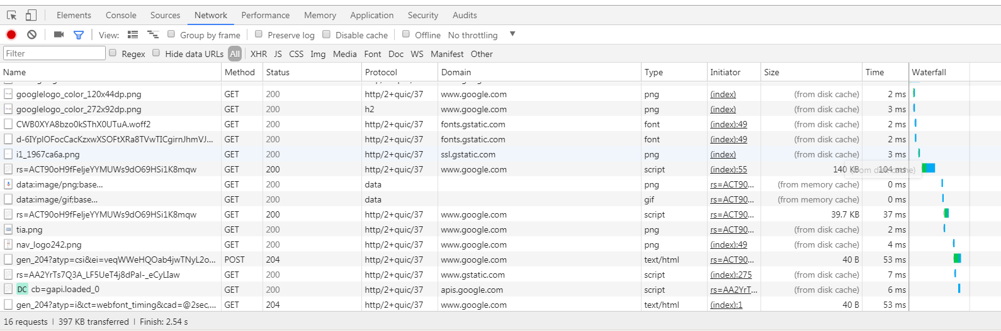
Main UI

Slide 14
General Info
How to open
Right-click -> Inspect
Windows: Ctrl + Shift + I or F12
Mac: Command + Option + I

Slide 15
Customization
Docking options
Shortcuts
Settings
Command Menu
Windows: Ctrl + Shift + P
Mac: Command + Shift + P
Notes:
Show how it can be docked in various ways
Settings (press F1) -> Shortcuts
Command Menu (Ctrl + Shift + P on Windows or Cmd + Shift + P on Mac) - easy way to find and interact with various settings
Show how to easily change the theme

Slide 16
Tab: Elements
Real-time page editing – HTML & CSS
JavaScript debugging
Notes:
Demo - edit a web page real-time – edit text, button color
Very easy to create screenshots with fake data from Facebook, Twitter and so on
Demo – JavaScript debugging
https://googlechrome.github.io/devtools-samples/debug-js/get-started
event listener for mouse click - show how to step through code, watch variables
before going to the network tab - audience exercise
Demo - how to track down an instance of mixed content
https://www.bennish.net/mixed-content.html

Slide 17
Tab: Network
Disable cache
Network throttling
Preserve log
Request filtering
Screenshots
Additional columns
Notes:
disable cache (while tools are open), network throttling, preserve log, additional columns to add to display grid
press Shift while hovering over a request to see who called it and who it called
filtering - type '-' to see the filtering options (such as larger-than, domain, status-code) ... when it starts with '-' it's the negative of that criteria
how to record with screenshots (screenshots only show the viewable area as seen when dev tools is open - might want to open dev tools in a separate window)
https://googlechrome.github.io/devtools-samples/network/gs/v1.html
Enable throttling - Large image, delay in js file (based on DOM display time)
discuss why mixed content is a problem and why it's blocked (look at cookie data when static resources are requested - could be intercepted over http)
HTTP/2 demo - https://http2.golang.org/gophertiles
Latency vs. bandwidth
use multiple tabs for 1.1 vs. 2 and show waterfall timeline and how requests are in blocks of 6

Slide 18
Device emulation (mobile)
Screen size – not CPU or memory
Modifies request headers
Screen orientation
Sensors
Notes:
headers are actually modified in requests
dev tools menu (upper right) -> More Tools -> Sensors (for changing geolocation, orientation and such when working with mobile device view)

Slide 19
Tab: Sources
Resources grouped by domain origin
Can map to local folder for development
Use Chrome as IDE
Challenges with minified content (Source Maps)
Notes:
map local site resources to what the browser sees in order to do real-time development (use Chrome as a complete IDE)
how to pretty format text when looking at minified sources ({} button)

Slide 20
Tab: Application
Usage of local browser resources
Local storage
Cache
Cookies

Slide 21
Tab: Security
Certificates & encryption

Slide 22
Tab: Audits
Performance best practices
Significant upgrade since Chrome version 60
now using Lighthouse project
https://www.webpagetest.org/
still a better resource
Notes:
shows web performance tips based on well-known best practices
as of Chrome version 60 it's using the Lighthouse project (test for Progressive Web Apps, only tests for Nexus 5s with a certain throttling emulation)
better than previous versions (more in-depth) but must offer better ways to configure / select the profiles used when testing
https://www.webpagetest.org/ is probably a much better starting point if you're trying to understand web app performance and best practices
must have access to site being tested (for public sites)
also offered as a software package for use on private servers (for private sites)

Slide 23
Tab: Performance
Screenshots
Timeline
JavaScript CPU & memory profiler
Notes:
records detailed data from the client side
tracks how interacting with a particular site affects local memory, request timing and so on

Slide 24
Fiddler
Notes:
Ask how many people heard of (or used) the tool

Slide 25
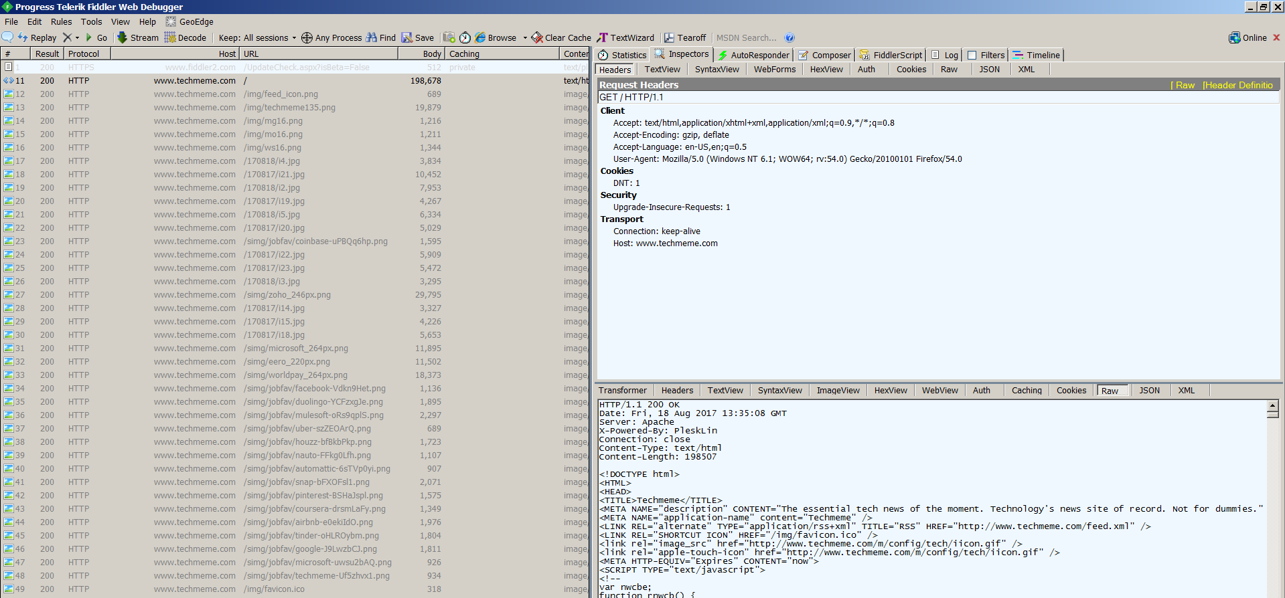
Main UI

Slide 26
Fiddler Facts
http://www.telerik.com/fiddler
Windows, Mac OS X (beta), Linux (beta)
Proxy server
HTTP debugger / traffic generator
Written in .NET / Mono
Free utility (maintained by Telerik)
Extensible application
Notes:
History – Eric Lawrence (author) started it as in-house tool at Microsoft around 2002 to help the Microsoft Clipart team
developer moved to Telerik and they own it now
it can also generate and modify traffic in addition to observing traffic that passes through

Slide 27
How Fiddler Works
Credit: https://www.slideshare.net/idof/debugging-the-web-with-fiddler-64802898
Notes:
Explain that Fiddler automatically modifies the overall proxy system values on application start/stop
Start the app and show the various areas – capture a session and look at the data present

Slide 28
Why still use Fiddler?
Multiple browsers and devices
Modify and reissue captured requests
FiddlerCap
http://www.telerik.com/fiddler/fiddlercap
capture and share sessions
Notes:
It used to be the go-to debugging tool for web traffic analysis but browser developer tools are getting better all the time
Browser dev tools enough for maybe 80% of the issues – for the remaining 20% use Fiddler for additional options & customization
Single tool to intercept and analyze traffic that can be used across multiple browsers and external devices
It can modify requests on the fly and reissue captured requests
With FiddlerCap it offers the ability to easily share web sessions with customers
demo FiddlerCap

Slide 29
Fiddler - Swiss Army knife
Browsers
Desktop applications that use HTTP
Web services
Phones & tablets
Any device that supports a proxy server
Notes:
Demo - intercept traffic from my phone (must be on same wireless network – IP address and port 8888)
open the CNET news app or USA Today (look at json return data with news articles)
Demo - resend a request with composer
https://mdn.github.io/learning-area/html/forms/sending-form-data/post-method.html
Demo - use auto responder to create a rule that does something when a particular request is made (return 404 status code for example)
Demo - image bloat rule to see how much metadata exists in images
Demo - explore image quality optimization
sort responses by size, look at ImageView Inspector, right-click on image Tools -> Explore Quality

Slide 30
Fiddler and HTTPS
“machine-in-the-middle”
on-the-fly certificates
Notes:
show how a site's certificate differs when traffic goes through Fiddler

Slide 31
Resources
https://fiddlerbook.com/book/
http://www.telerik.com/fiddler/fiddlercap
https://www.webpagetest.org/
https://developers.google.com/web/tools/chrome-devtools/
https://www.youtube.com/watch?v=KykP5Z5E4kA
Chrome DevTools Masterclass
https://caniuse.com/

Slide 32

Notes:
Stay curious and explore
Learn the tools you work with often so you can be more efficient

Slide 33

Notes:
Any questions?

